Slide 1
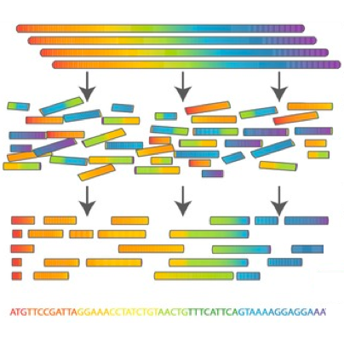

Scientific Computing for Biologists

Slide 2
Scientific Computing for Biologists
5-10 minutes for class discussion and dialog over previous lesson(s)…
Questions about previous lecture(s)?
Discussion of Final Project progress?
General Questions about scientific computing?

Slide 3
Scientific Computing for Biologists
So, let’s look at some new system commands to incorporate:
whoami – who does the computer recognize you as?
w, who – who else is logged into the same computer?
uptime – how long has the computer been running without reboot?
uname (-a) – detailed info about the operating system
free – display information on system memory (not on Mac OSX)
df – display information on system disk storage and layout
du – display disk usage
ps – process (job or task) status
kill – stop or interrupt processes
top – dynamic tool to display system stats
With these in mind, now let’s write some short shell scripts!

Slide 4
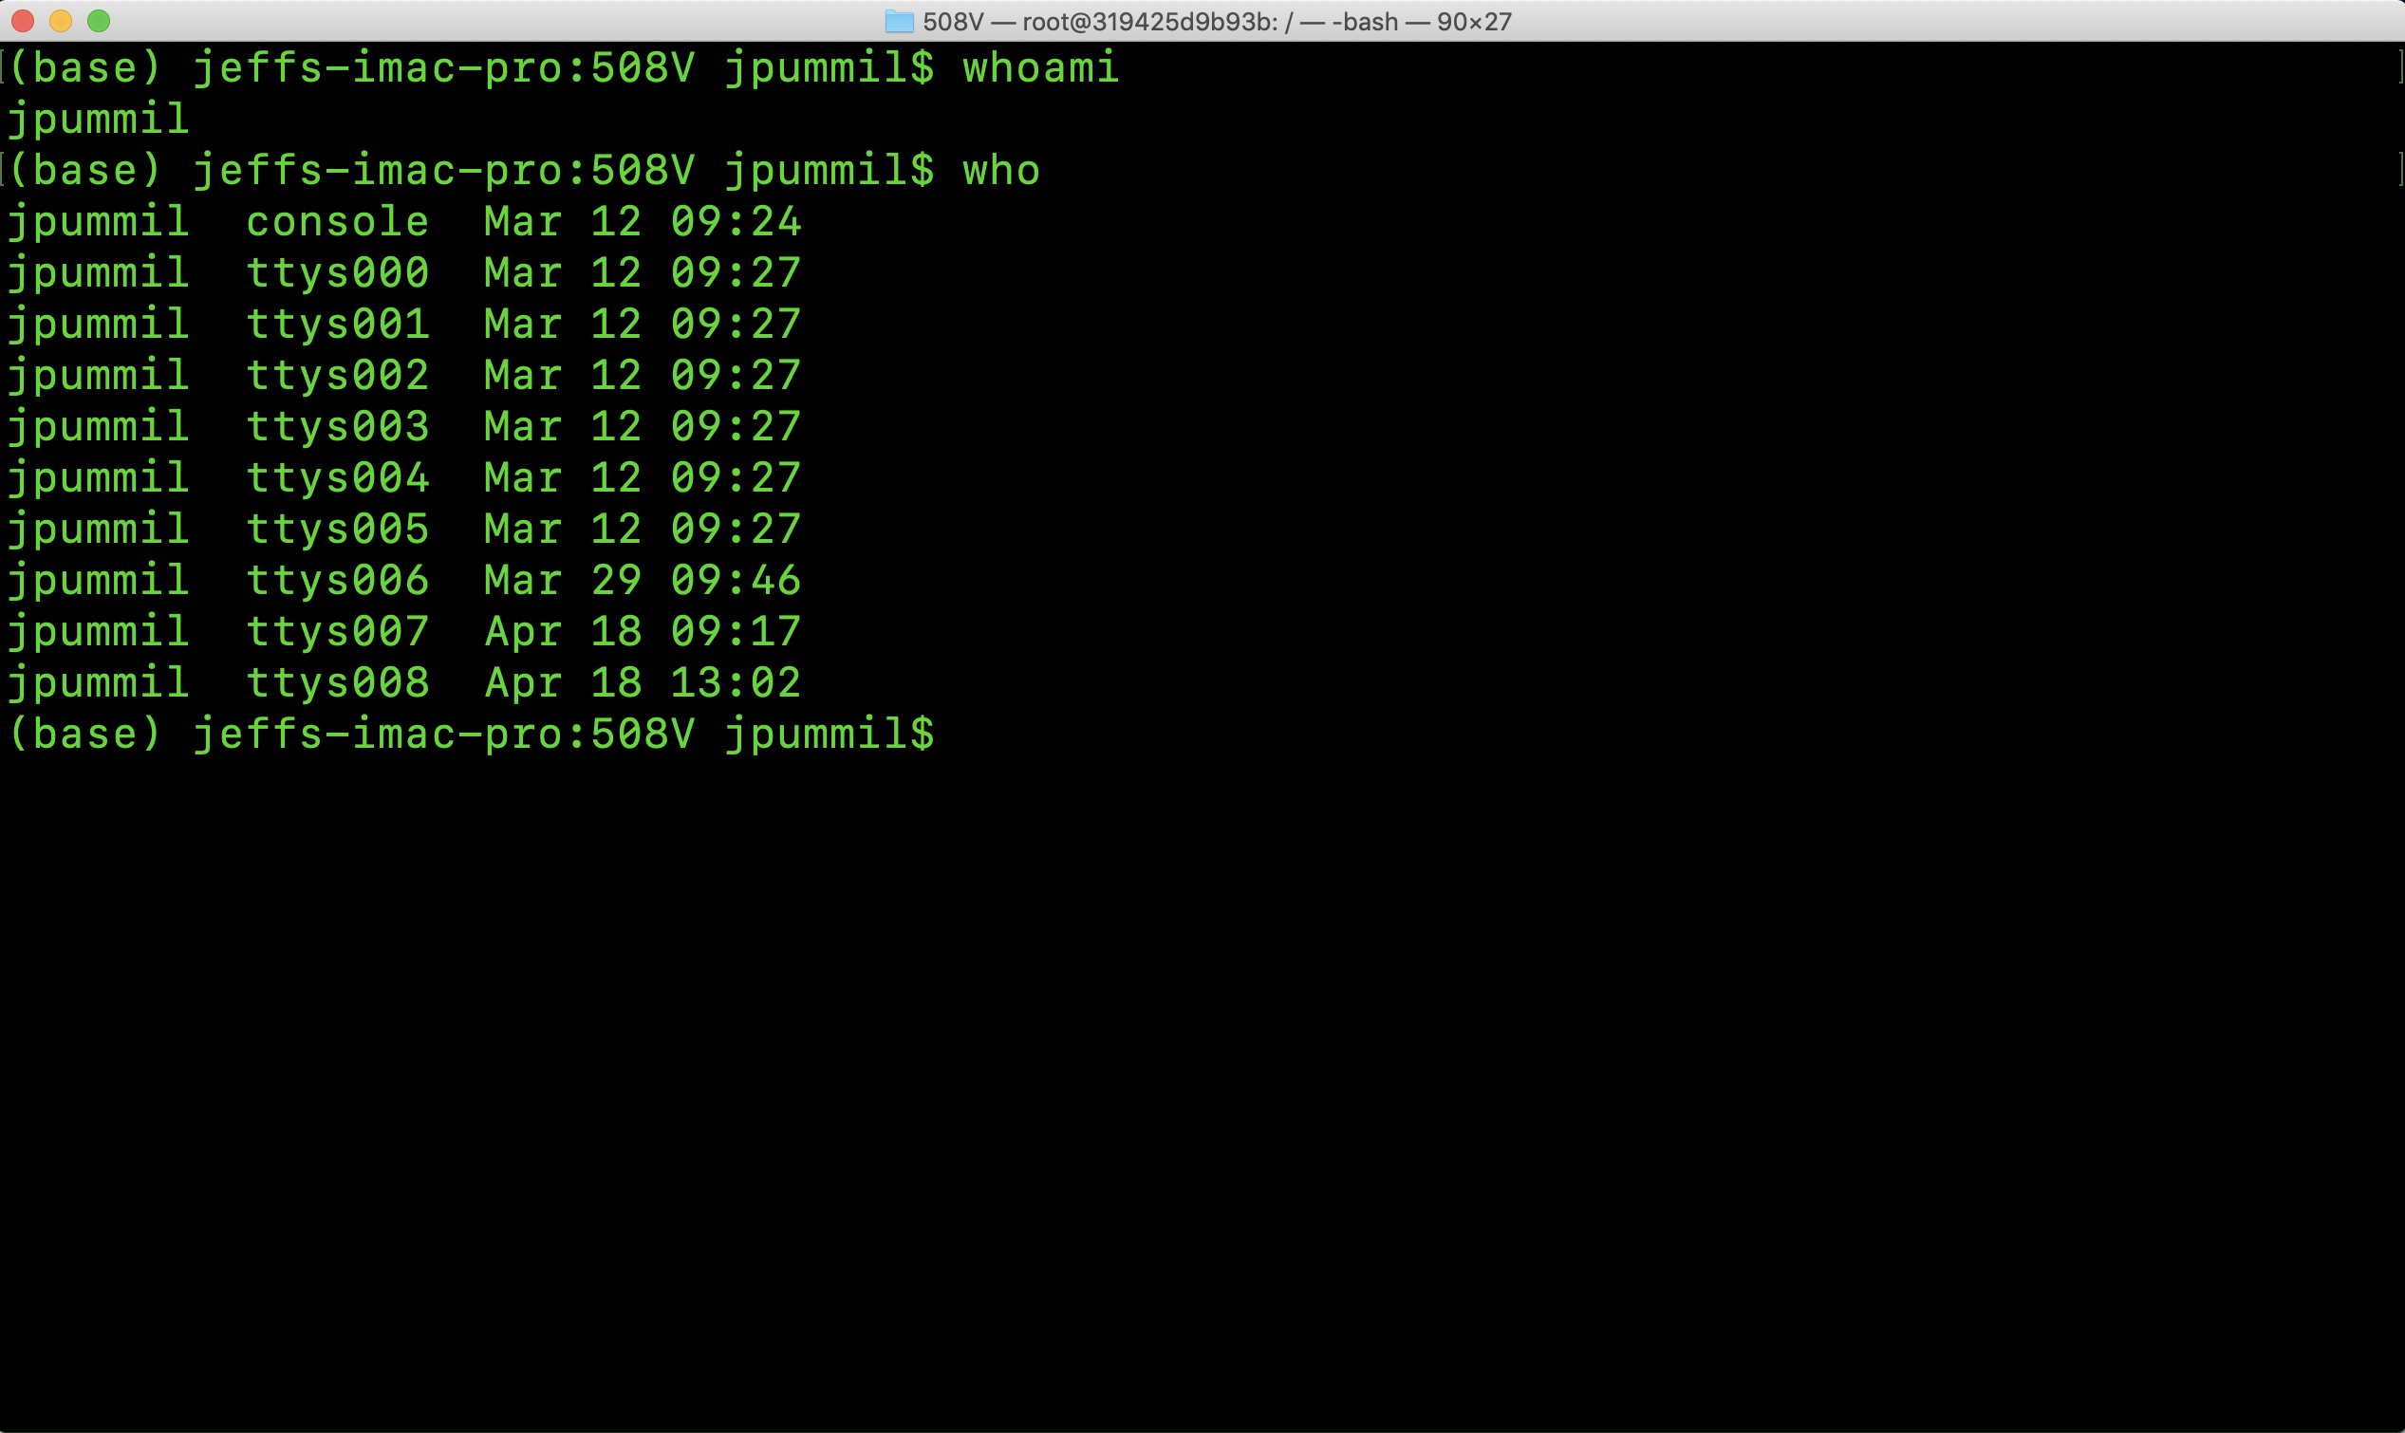
Scientific Computing for Biologists

Slide 5
Scientific Computing for Biologists
So, let’s look at some new system commands to incorporate:
whoami – who does the computer recognize you as?
w, who – who else is logged into the same computer?
uptime – how long has the computer been running without reboot?
uname (-a) – detailed info about the operating system
free – display information on system memory (not on Mac OSX)
df – display information on system disk storage and layout
du – display disk usage
ps – process (job or task) status
kill – stop or interrupt processes
top – dynamic tool to display system stats
With these in mind, now let’s write some short shell scripts!

Slide 6
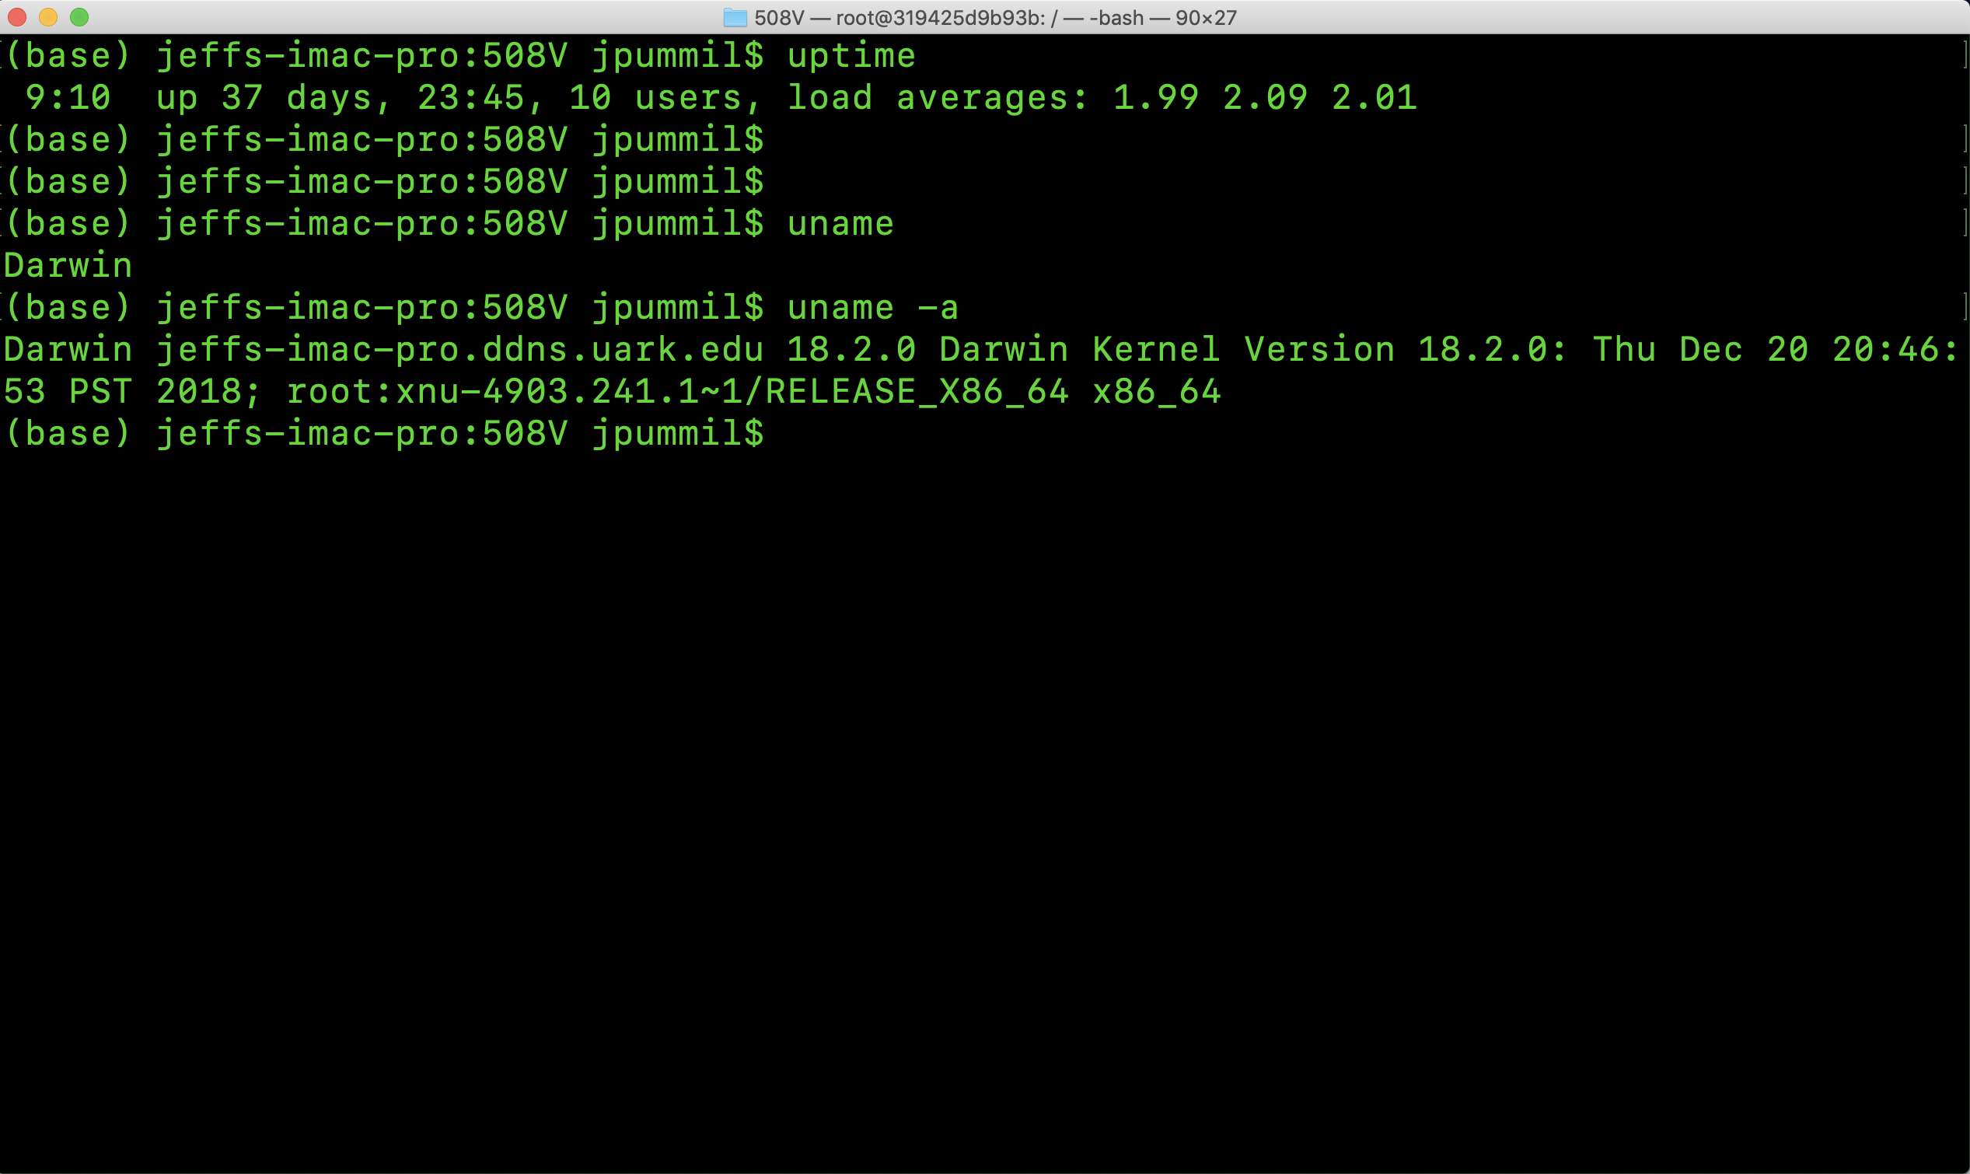
Scientific Computing for Biologists

Slide 7
Scientific Computing for Biologists
So, let’s look at some new system commands to incorporate:
whoami – who does the computer recognize you as?
w, who – who else is logged into the same computer?
uptime – how long has the computer been running without reboot?
uname (-a) – detailed info about the operating system
free – display information on system memory (not on Mac OSX)
df – display information on system disk storage and layout
du – display disk usage
ps – process (job or task) status
kill – stop or interrupt processes
top – dynamic tool to display system stats
With these in mind, now let’s write some short shell scripts!

Slide 8
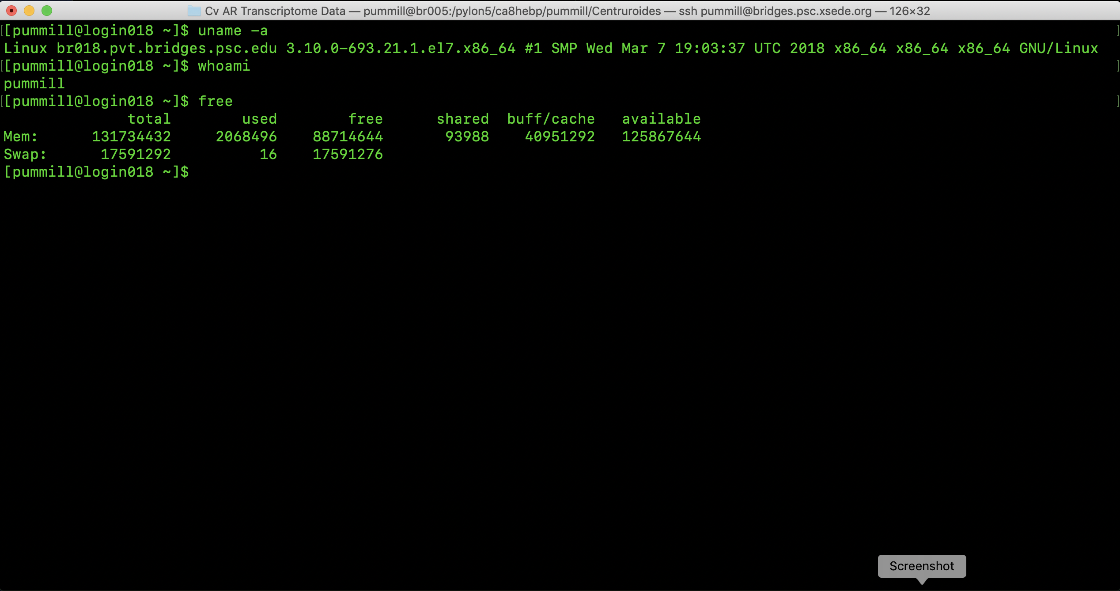
Scientific Computing for Biologists

Slide 9
Scientific Computing for Biologists
So, let’s look at some new system commands to incorporate:
whoami – who does the computer recognize you as?
w, who – who else is logged into the same computer?
uptime – how long has the computer been running without reboot?
uname (-a) – detailed info about the operating system
free – display information on system memory (not on Mac OSX)
df – display information on system disk storage and layout
du – display disk usage
ps – process (job or task) status
kill – stop or interrupt processes
top – dynamic tool to display system stats
With these in mind, now let’s write some short shell scripts!

Slide 10
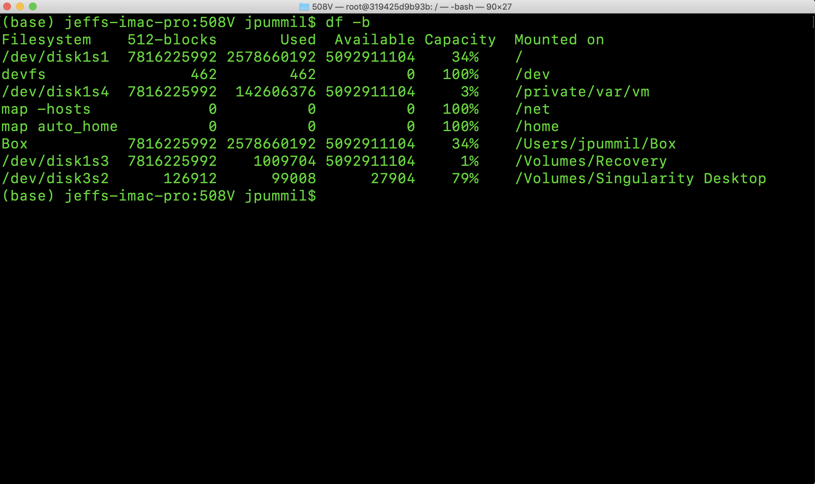
Scientific Computing for Biologists

Slide 11
Scientific Computing for Biologists
So, let’s look at some new system commands to incorporate:
whoami – who does the computer recognize you as?
w, who – who else is logged into the same computer?
uptime – how long has the computer been running without reboot?
uname (-a) – detailed info about the operating system
free – display information on system memory (not on Mac OSX)
df – display information on system disk storage and layout
du – display disk usage
ps – process (job or task) status
kill – stop or interrupt processes
top – dynamic tool to display system stats
With these in mind, now let’s write some short shell scripts!

Slide 12
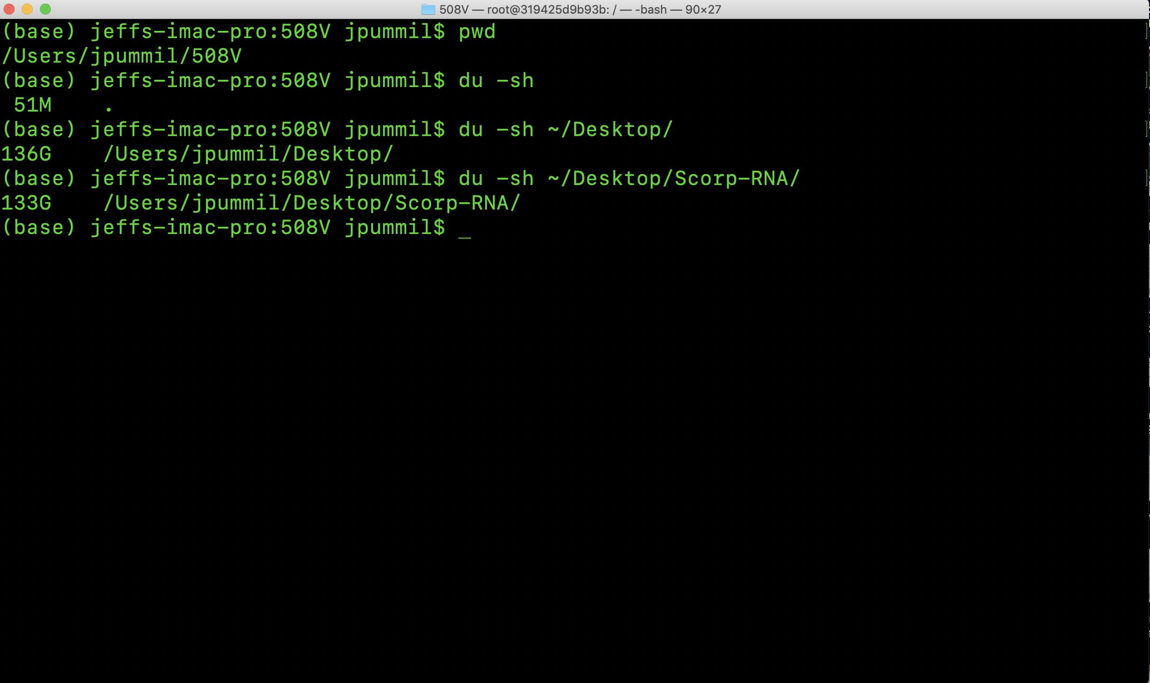
Scientific Computing for Biologists

Slide 13
Scientific Computing for Biologists
So, let’s look at some new system commands to incorporate:
whoami – who does the computer recognize you as?
w, who – who else is logged into the same computer?
uptime – how long has the computer been running without reboot?
uname (-a) – detailed info about the operating system
free – display information on system memory (not on Mac OSX)
df – display information on system disk storage and layout
du – display disk usage
ps – process (job or task) status
kill – stop or interrupt processes
top – dynamic tool to display system stats
With these in mind, now let’s write some short shell scripts!

Slide 14
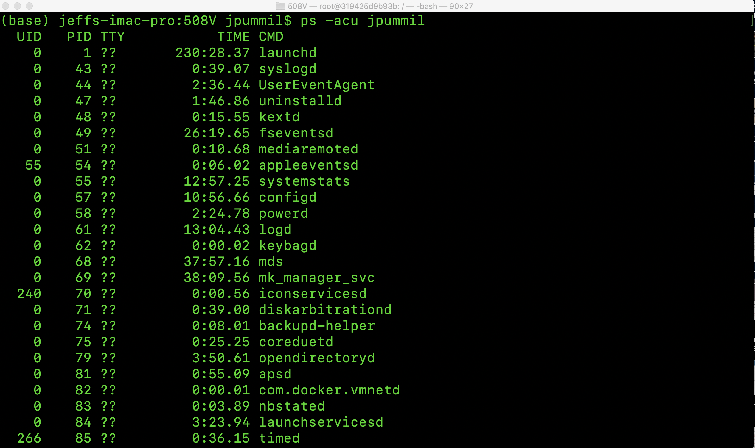
Scientific Computing for Biologists

Slide 15
Scientific Computing for Biologists
So, let’s look at some new system commands to incorporate:
whoami – who does the computer recognize you as?
w, who – who else is logged into the same computer?
uptime – how long has the computer been running without reboot?
uname (-a) – detailed info about the operating system
free – display information on system memory (not on Mac OSX)
df – display information on system disk storage and layout
du – display disk usage
ps – process (job or task) status
kill – stop or interrupt processes
top – dynamic tool to display system stats
With these in mind, now let’s write some short shell scripts!

Slide 16
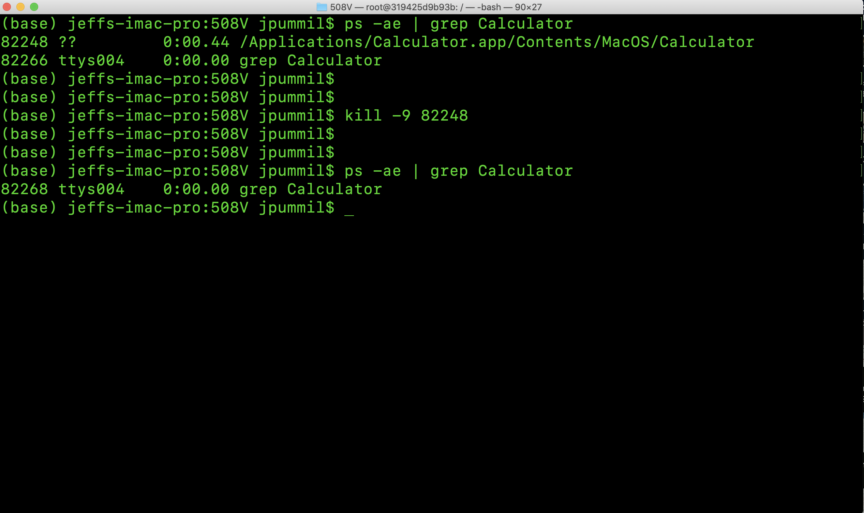
Scientific Computing for Biologists

Slide 17
Scientific Computing for Biologists
So, let’s look at some new system commands to incorporate:
whoami – who does the computer recognize you as?
w, who – who else is logged into the same computer?
uptime – how long has the computer been running without reboot?
uname (-a) – detailed info about the operating system
free – display information on system memory (not on Mac OSX)
df – display information on system disk storage and layout
du – display disk usage
ps – process (job or task) status
kill – stop or interrupt processes
top – dynamic tool to display system stats
With these in mind, now let’s write some short shell scripts!

Slide 18
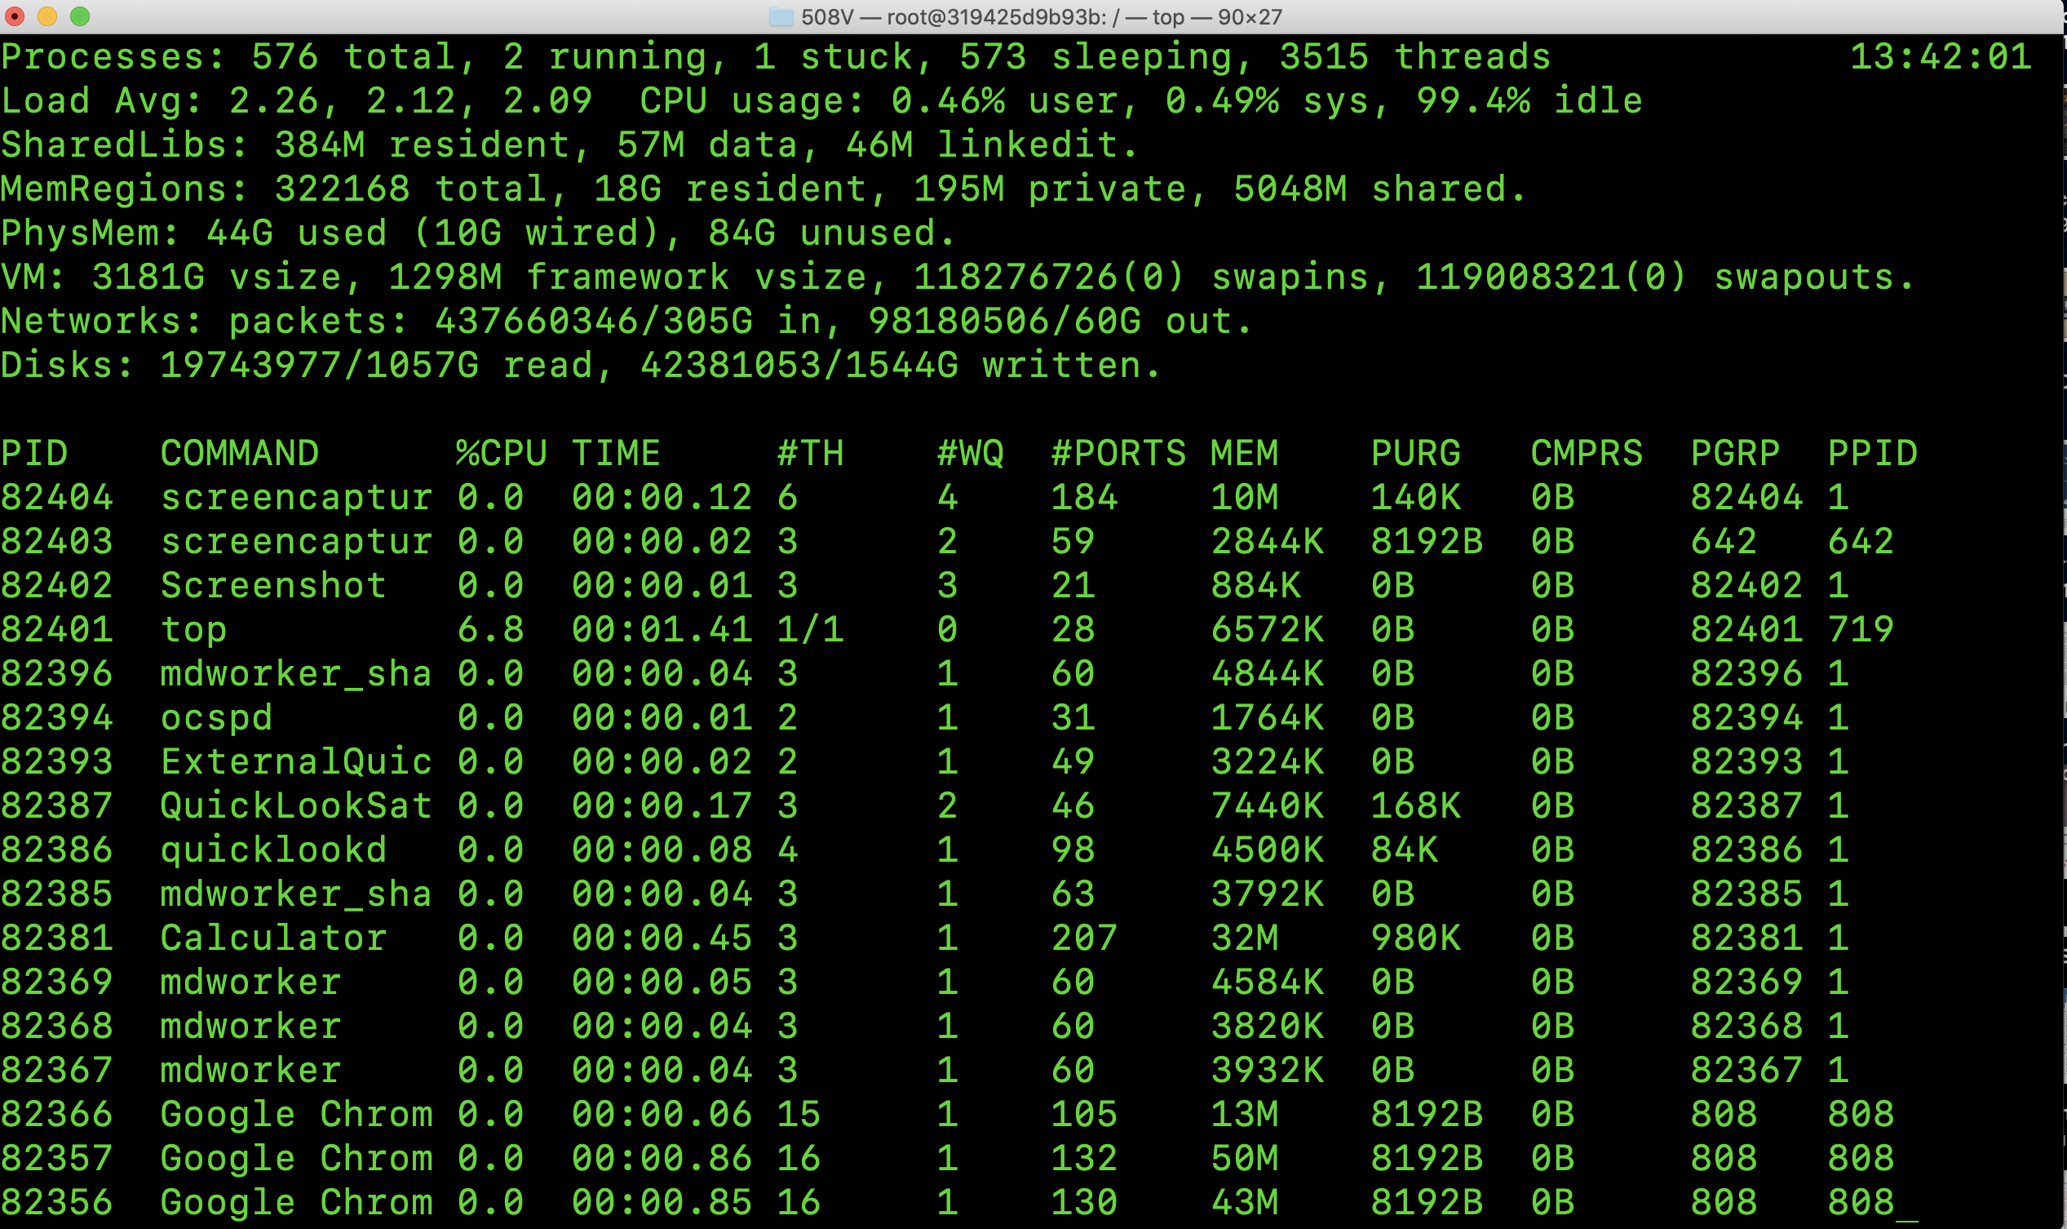
Scientific Computing for Biologists

Slide 19
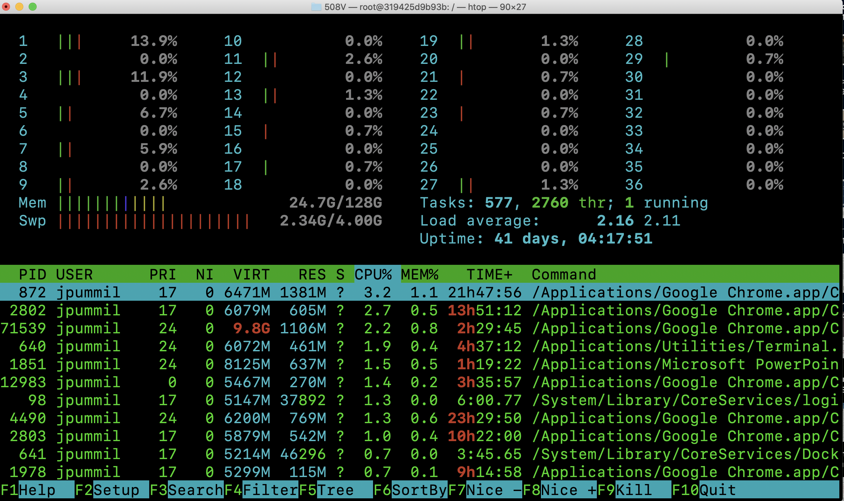
Scientific Computing for Biologists

Slide 20
Scientific Computing for Biologists
Half time!
5-10 minute break…

Slide 21
Scientific Computing for Biologists
For the rest of this class session, experiment with:
Using the commands you have learned this week with their various flags, think about and experiment with your own unique combinations.
Search for an acceptable alternative command for “free” which does work on OSX/Mac.
Determine the answers using what you’ve learned so far:
How many processes are running on your iMac?
How much space is Used/Available on your harddisk?
How long has your iMac been running since last reboot?
How much space are you using in /usr/bin?

Slide 22
Scientific Computing for Biologists
Great web site for TONS of examples:
https://www.thegeekstuff.com/
https://explainshell.com/

Slide 23
Scientific Computing for Biologists
Jeff Pummill
Director – Strategic Initiatives & User Services
Arkansas High Performance Computing Center
Adjunct Graduate Faculty – Biological Sciences
University of Arkansas – JBHT 410
jpummil@uark.edu
@jpummil on Twitter

